Slide 1
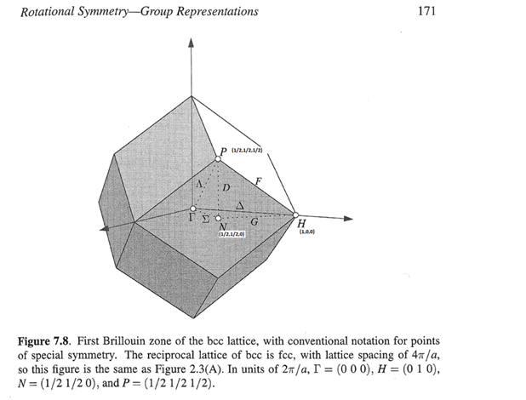
Good for GN
w2nbg = cut(src_nobg,line_proj,0.04,0.04,[-0.1,0.1],[90,110])

Slide 2
GN, Ei200

Slide 3
GN, Ei400

Slide 4
GN (ei400)

Slide 5
GN800

Slide 6
GN800

